Slide 1
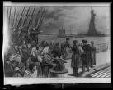
Immigrants in America
Millions of immigrants moved to the United States in the late 1800’s & early 1900’s.

Slide 2
Immigration Stations
Once immigrants arrived in the U.S., they went through immigration stations, such as Ellis Island in New York Harbor. Government workers questioned them about where they planned to work & live. Doctors also examined them to make sure they didn’t have any diseases. Almost all European immigrants were allowed to enter the U.S.

Slide 3
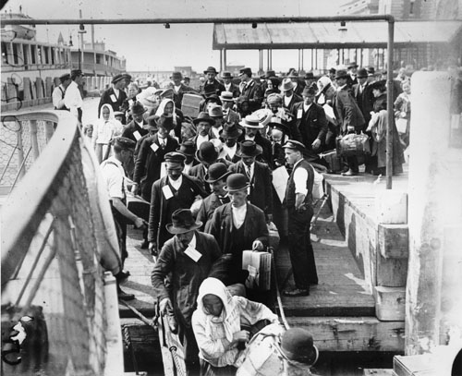
New immigrants arriving at Ellis Island. At Ellis they will be "processed" before they are allowed to continue their journey to find a new home.

Slide 4
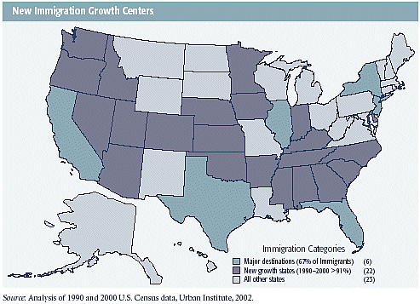

Slide 5
Laws Against Immigration
1882 Congress passed Chinese Exclusion Act
Almost all Chinese immigrants were kept out of America
1921 & 1924 Congress passed laws that lowered the number of Europeans & Asians
All immigrants faced prejudice upon arrival

Slide 6
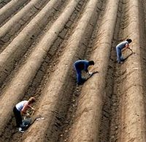
Immigrants helped the U.S. become one of the richest and fastest-growing countries in the world. They built railroads, dug mines, and worked in factories.

Slide 7
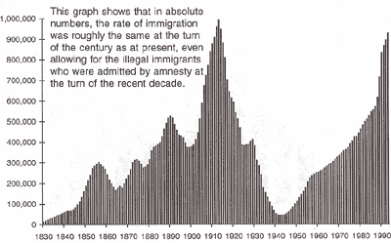

Slide 8
This powerpoint was kindly donated to www.worldofteaching.com
http://www.worldofteaching.com is home to over a thousand powerpoints submitted by teachers. This is a completely free site and requires no registration. Please visit and I hope it will help in your teaching.

